Slide 1
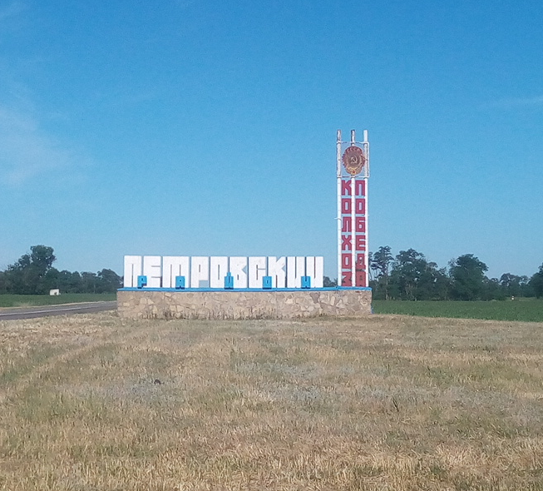
Investment potential
Petrovsky city
district
Stavropol Territory

Slide 2
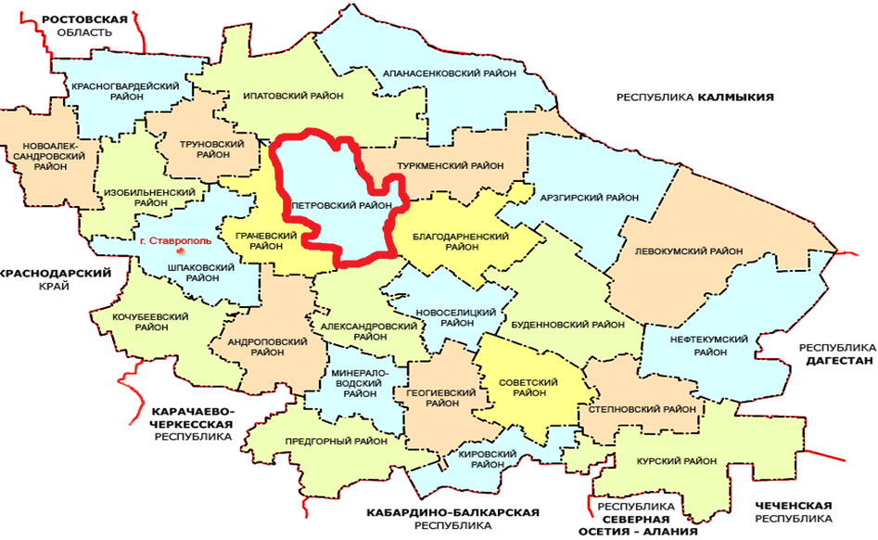
Petrovsky city district
Geographic location of the district

Slide 3
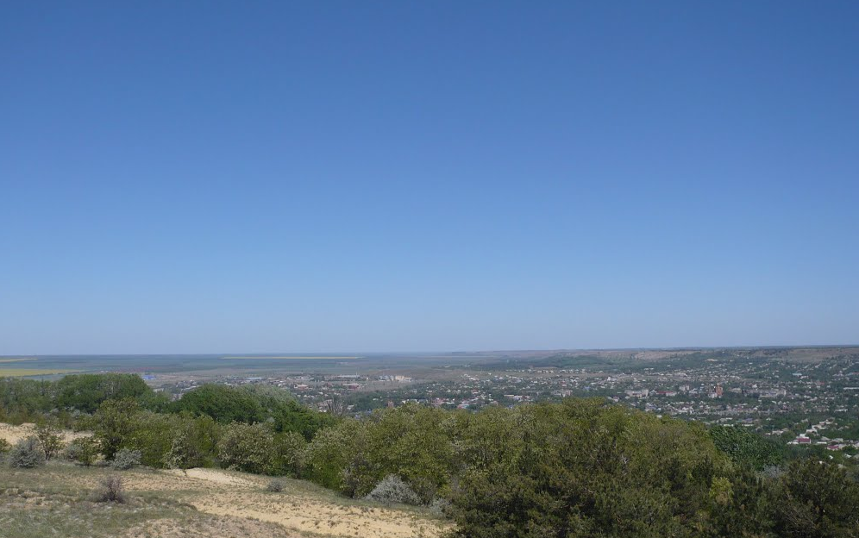
Petrovsky city district
Area and population of the district
The area of the Petrovsky urban district is 274.1 thousand hectares
The area of agricultural land is 253.0 thousand hectares
Population 73051 people.

Slide 4
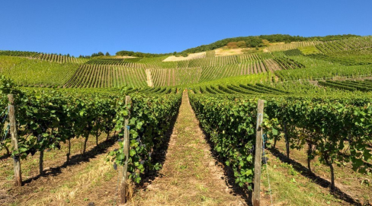
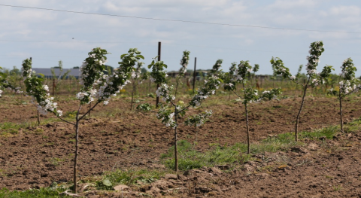
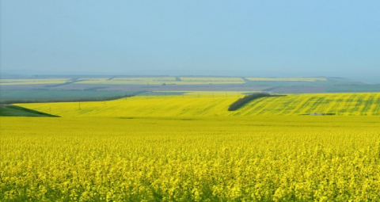
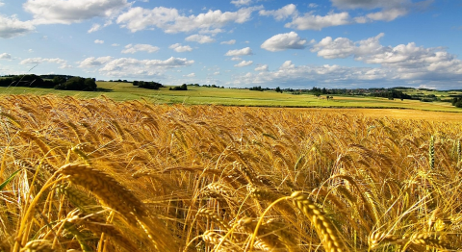
Petrovsky city district
Agriculture
Petrovsky urban district is located in the II soil and climatic zone of the Stavropol Territory in the west and south predominate - chestnut chernozems in combination with pre-Caucasus chernozems, in the east and north - dark chestnut and chestnut soils

Slide 5
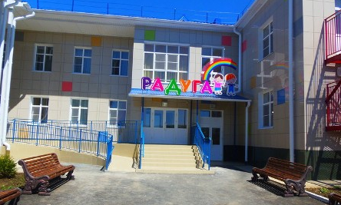
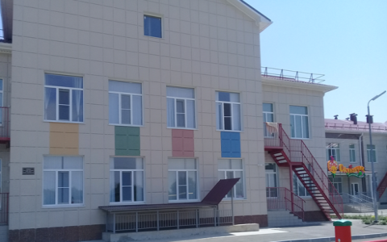
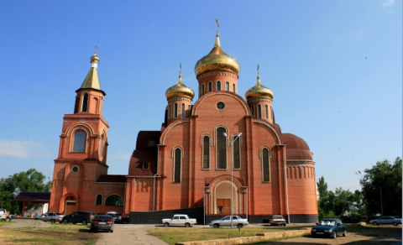
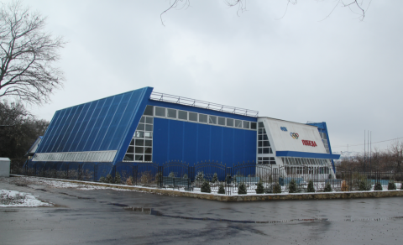
Petrovsky city district
Social infrastructure of Petrovsky urban district
Kindergarten № 47 Rainbow
Kindergarten № 48 Dandelion
Church of St. Nicholas the
Wonderworker
Fitness and health
Victory complex

Slide 6
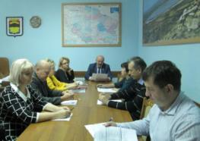
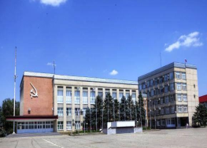
Petrovsky city district
INVESTOR SUPPORT MEASURES
Progressive regulatory framework in the field of investment
Coordination and advisory body - "Investment Council"
The system of operational control over the implementation of investment projects at the level of the Head of Administration of Petrovsky urban district
The authorized body on attraction of investments and support of investment projects operates
The reinforcement of curators from among the deputy heads of the administration of the Petrovsky urban district for investment projects

Slide 7
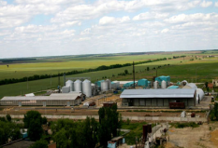
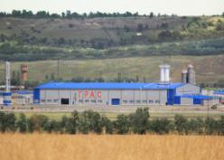
Petrovsky city district
PREFERENCES FOR INVESTORS AT THE ACCOUNT OF THE RED BUDGET
A 70% reduction in the rental rate for the use of property owned by the Stavropol
A 95% reduction in the rental rate for the use of production and office premises, facilities and buildings, equipment and other resources owned by the Stavropol Territory
Decrease in the profit tax rate for business entities by 4.5% - for the estimated payback period set by the investment project and by 2.5% - after the payback of the investment project
Provision of state guarantees to investors implementing investment projects that correspond to priority areas of investment activity in the territory of the Stavropol Territory.
The tax rate of 5%
Property tax 0% within 5 years after the adoption of the property as an object of fixed assets.

Slide 8
Petrovsky city district
Large investment projects Investment size

Slide 9
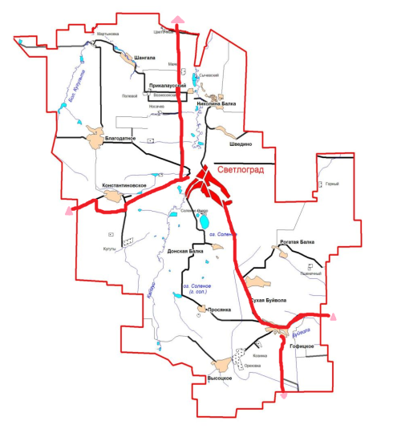
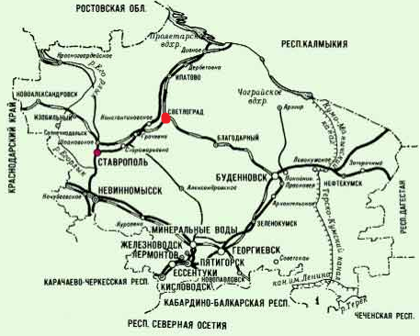
Petrovsky city district
TRANSPORT INFRASTRUCTURE
Car roads
Railway
Elista
Distance:
Stavropol - 47 miles
Budennovsk - 135 miles
Mineral Waters - 157 km
Elista -195km
Stavropol
Budennovsk
Mineral Waters

Slide 10
Petrovsky city district
DIRECTIONS OF INVESTMENT
The transition to an innovative type of development, the modernization of enterprises in the main sectors of the economy with the replacement of obsolete and worn out equipment with modern ones.
Creation of complexes for the production and deep processing of agro-industrial products.
Production of import-substituting and export-oriented products, including agricultural products.
Increase of economic efficiency of inter-district and inter-regional transportations on territory of district.
Creation and development of engineering infrastructure for investment sites.
Assistance to subjects of investment activity on participation in programs of state support of investment activity.
Implementation of budget investments in the social sphere.
Introduction of mechanisms of public-private partnership

Slide 11
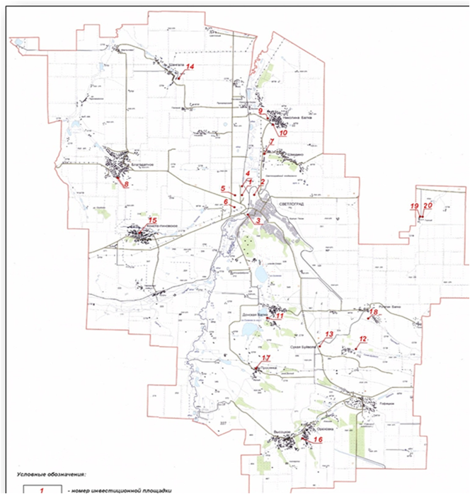
Petrovsky city district
The scheme of location of free investment sites
ploshchadki № 1-6 (g.Svetlograd)
ploshchadka № 7 (s.Shvedino)
ploshadka №8 (s. Blagodatnoye)
ploshadka №9-10 (s. Nikolina Balka)
ploshadka №11 (s. Donskaya Balka)
ploshadka №12-13 (s. Sukhaya Buyvola)
ploshadka №14 (s. Shangala)
ploshchadki № 15, (s.Konstantinovskoye)
ploshadka №16 (s. Orekhovka)
ploshadka №17 (s. Prosyanka)
ploshchadka № 18 (s.Rogataya Balka)
ploshchadka №19-20 (p. Gornyy)

Slide 12
Petrovsky city district
WE INVITE YOU TO A LONG-TERM AND MUTUALLY BENEFICIAL
COOPERATION!
Administration of the Petrovsky urban district of the Stavropol Territory
356530 Svetlovgrad, pl. 50 years of October 8
Phone: 8 (86547) 4-11-95, Fax: 8 (86547) 4-10-76,
E-mail: petr.adm@mail.ru

